Slide 1
A Unified Architecture for Accelerating Distributed DNN Training in Heterogeneous GPU/CPU Clusters
Di Qu, Zixuan Lu
Paper 8

Slide 2
BytePS: Use everything you have

Slide 3
Background
Variables:
M: Model size
n: # GPU Machines
k: # CPU Machine
B: Network Bandwidth
Two popular architechture:
All-Reduce
Parameter Server
One iteration of training
calculate the gradient from the subset of data assigned to the machine
Aggregate the gradient
Update the parameters

Slide 4


All-Reduce:
Use GPU for all operations.
T = 2 (n-1)M / nB
Parameter Server
Use GPU for FP and BP
Use CPU server to aggregate and update the parameters
Non-colocate:max(M/B, nM/kB)
Colocate: 2(n-1)M/nB

Slide 5


Slide 6
Motivation
There are spare CPUs and bandwidth in production GPU clusters
All-reduce: No usage of CPU server and local CPUs for gradient aggregation and summation
Parameter Server: No usage of local CPU in GPU server
Therefore, the author provide a new architecture: BytePS

Slide 7
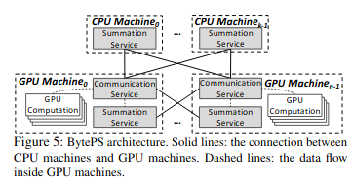
Summation Service:
Aggregate the gradients
Runs on Every server’s CPU
SS only talks to CS
Communication Service:
Internally synchronizing the tensors among local GPUs
Externally communicating with SS
Must Send and Receive M bytes

Slide 8






Inter-Communication
:Bytes assigned to each CPU Server
:Bytes assigned to each GPU server

Slide 9
Intra-machine Communication
We need to design the structure of intra-communication between CPU and GPU. It is equally important to Inter-machine Communication
Two most common setup:
PCIe-only Topology
NVLink-based Topology

Slide 10
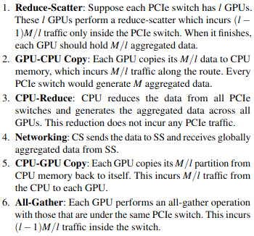
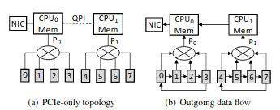

Slide 11
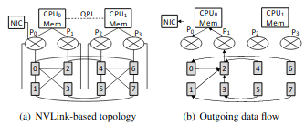
NVLink-based Topology
Four PCIe switches connecting two GPU cards
GPUs are also connected via NVLinks
It avoids consuming PCIe bandwidth
However, the existing framework is not optimal
It is non-symmetric considering the NIC only connects to one PCIe

Slide 12
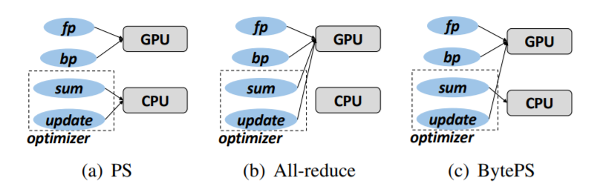
Summation Service
Notes:
Address cpu bottleneck

Slide 13
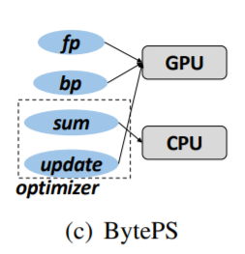
Summation Service - Architecture
Problem: CPU bottleneck due to limited memory bandwidth.
Solution: exploiting CPU’s summation ability
Drawback: Re-computation of the same parameter update calculation at each GPU, whereas traditional PS needs only to compute once.

Slide 14
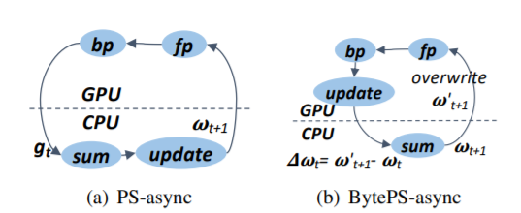
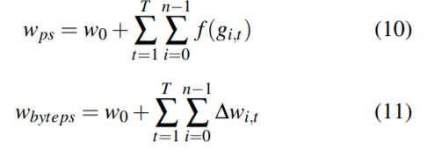
Summation Service - Asynchronous Training
Problem: Asynchronous Parallel relies on the PS processes keeping the most updated model parameters, which is not directly compatible with the design of SS.
Solution: A new workflow is introduced. The updated parameters are obtained by:
Workflow comparison between PS and BytePS
Notes:
Proved by induction

Slide 15
Implementation Details
Use multi-stage pipeline to speed up a multi-step procedure
Use shared memory data path to avoid internal incast (which will push NIC to generate PFC)
Use page-aligned memory for RDMA. Otherwise PFC may be generated.
BytePS has a Python interface that is almost identical to Horovod, PyTorch native API and TensorFlow native API.
Notes:
CS has six steps

Slide 16
Evaluation - Highlights
Large training batch sizes are used: improvement in end-to-end communication is reduced. Hence, the results only represent the lower bound of BytePS.
Models that are used internally for testing are highly representative of common production workloads.
Comparison are made with the state-of-the-art PS and allreduce implementation without modification.
Notes:
3. So the improvements better represent the system design effort

Slide 17
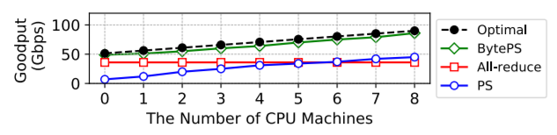
Evaluation - Inter-Machine Communication Benchmarks
Communication goodput(application-level throughput of a communication) of 8 * 1-GPU machines with varying number of additional CPU machines.

Slide 18
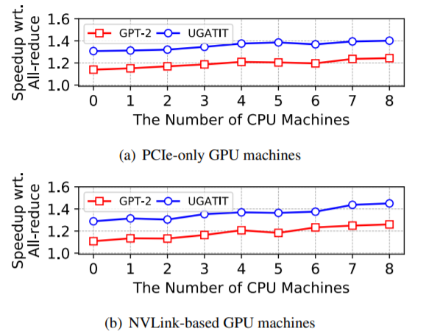
Evaluation - Leverage CPU Machines
End-to-end performance with different number of CPU machines.

Slide 19
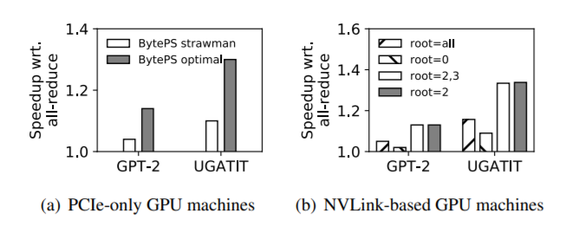
Evaluation - Intra-machine Topology
The test is run without CPU machines. One thing to note is BytePS outperforms all-reduce even without extra CPU machines due to allowing more “asynchronicity” than all-reduce.

Slide 20
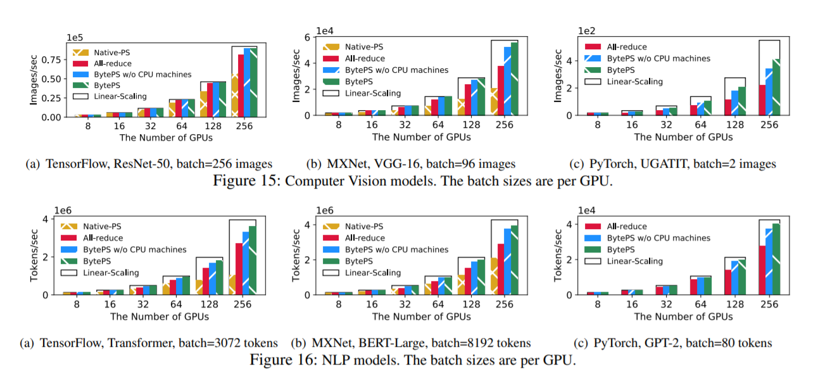
Evaluation - Generalizability and Scalability

Slide 21
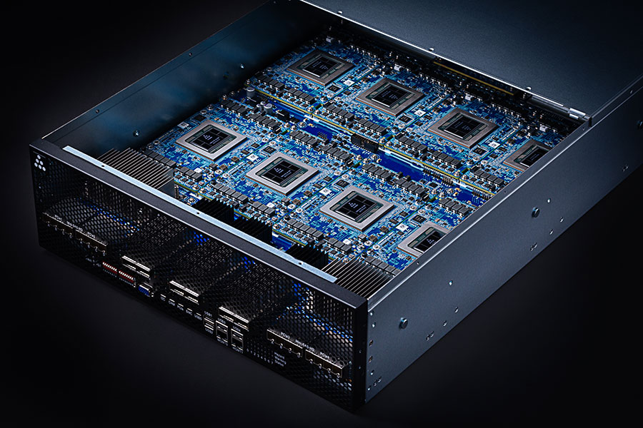
Discussion
Acceleration of computation and acceleration of communication techniques are complementary to and can be used with BytePS.
New hardware chips or architecture for accelerating DNN training can benefit BytePS

Slide 22
Conclusion and Summary
BytePS is a unified distributed DNN training acceleration system.
BytePS has good scalability and generalizability: BytePS handles cases with varying number of CPU machines and makes traditional all-reduce and PS as two special cases of its framework.
BytePS proposes Summation Service and a new workflow to fully utilize CPU and keep the ability to train asynchronously.
BytePS has been deployed, extensively used and open sourced. The APIs are kept almost identical to mainstream frameworks for learnability.

Slide 23
Questions?

